Slide 1
Load Balancing for Partition-based Similarity Search
Date : 2014/09/01
Author : Xun Tang, Maha Alabduljalil, Xin Jin,
Tao Yang
Source : SIGIR’14
Advisor : Jia-ling Koh
Speaker : Sheng-Chih Chu

Slide 2
Outline
Introduction
All Pair Similarity Search
Partition-based Similarity Search
Load Assignment Problem
Load Banlancing Optimization
Two-stage algorithm
Data Partition Optimization
Experiments
Conclusion

Slide 3
Introduction
All Pair Similarity Search(APSS),which identifies similar objects in a dataset.
The complexity of nave APSS can be quadratic to the dataset size.
Documents
(n item)
1.Compare with pair(n*n)
2.If Sim(di,dj) >= threshold
Output pair
Notes:
APSS用於很多應用，應用於物件的相似度,使用者興趣，比如網站相似性、推薦字查詢相似、抄襲辨認、廣告詐欺、垃圾郵件、重複檢測……
但兩兩相對比較的情況下，正常是要n^2的比較次數，為了降低其比較次數發展了Partition-based Similarity Search

Slide 4
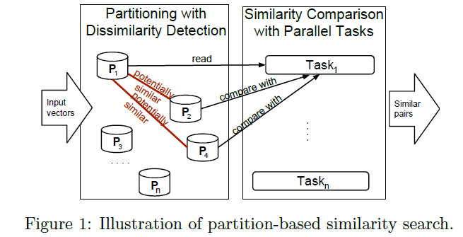
Partition-based Similarity Search
Divides the dataset into a set of partitions.
Assigns a partition to each task and each task compares this partition with other potentially similar partitions.
Documents
vector
(n item)
Notes:
為了避免不必要的IO存取時間和比較次數，將資料切成一系列的partitions，在這過程中有採一種策略，將可能相似的部分標記起來。
這策略是採[3]的論文方式，是以範數r-norm去計算特徵值

Slide 5
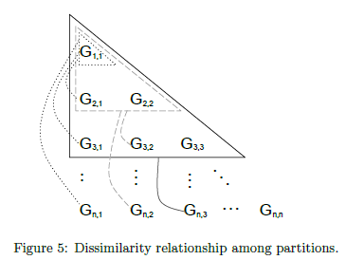
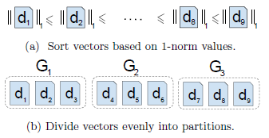
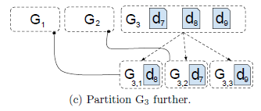
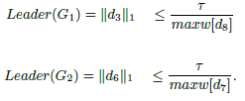
Partition With Dissimilarity Detection

Slide 6
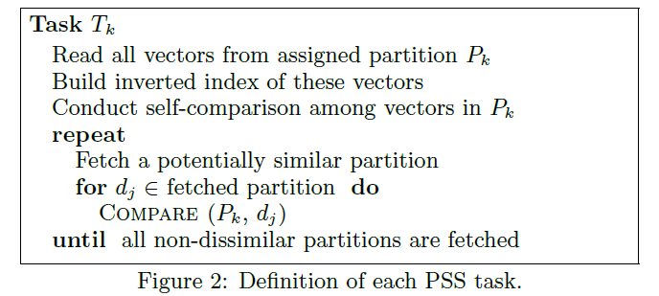
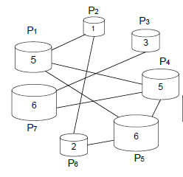
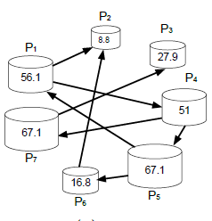
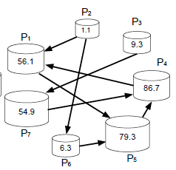
Notes:
Circuler Mapping Solution[3] : 如果task的數目是奇數且相連的邊必須是可能有關係，採用這目的是不會使某一個task工作太重
但是當資料集很大，數據出來的比例還是有差到很多

Slide 7
Outline
Introduction
All Pair Similarity Search
Partition-based Similarity Search
Load Assignment Problem
Load Banlancing Optimization
Two-stage algorithm
Data Partition Optimization
Experiments
Conclusion

Slide 8
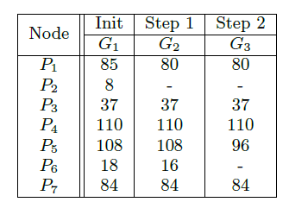
Load Banlancing Optimization

Slide 9
Stage1 - Initial Load Assignment
 | G1 | G2 | G3 | G4 | G5 | G6 | G7
P1 | 85 | 80 | 80 | 80 | 80 | 55 | _
P2 | 8 | _ | _ | _ | _ | _ | _
P3 | 37 | 37 | 37 | _ | _ | _ | _
P4 | 110 | 110 | 110 | 110 | 80 | _ | _
P5 | 108 | 108 | 96 | 96 | 96 | 66 | 36
P6 | 18 | 16 | _ | _ | _ | _ | _
P7 | 84 | 84 | 84 | 66 | _ | _ | _

Slide 10
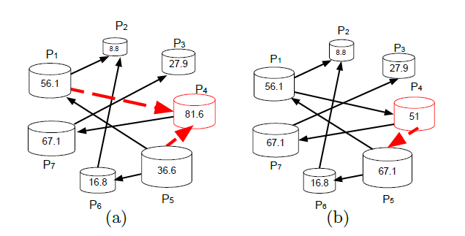
Stage-2 Assugnment Refinement
Step :
1.select P4 (max cost)
2.P4’s incoming neighbors is P1 and P5(selected min cost)
3.Reverse dirction of selected edge.
4.Check P5’s cost(67.1) > P4’s original cost(81.6)
true : reject its edge
false : continue step1

Slide 11
Data Partition Optimization
Dissimilar Detection with Holder’s Inequality.
Step :
1.Sort all vector based on 1-norm and divide its into l layers
2. Subdivide each layer .ex :L_{1,1},L_{2,1},L_{2,2},……L_{i,j}.

Slide 12
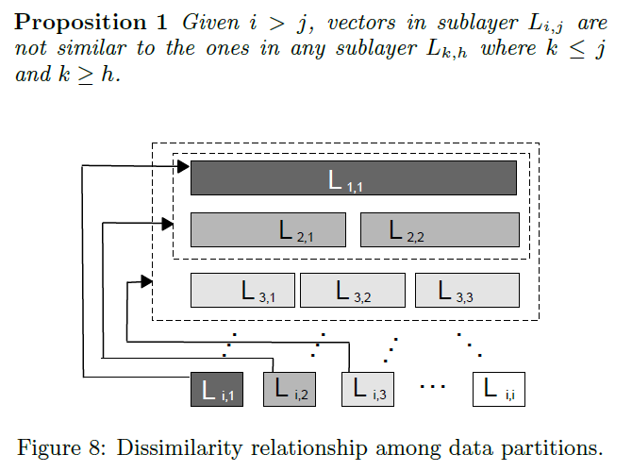
Ex: d₁,d₂,d₃,d₄……d₉ and
L1:{d₁,d₂,d₃}
L2:{d₄,d₅,d₆}
L3:{d₇,d₈,d₉}
Notes:
L1,1:

Slide 13
Outline
Introduction
All Pair Similarity Search
Partition-based Similarity Search
Load Assignment Problem
Load Banlancing Optimization
Two-stage algorithm
Data Partition Optimization
Experiments
Conclusion

Slide 14
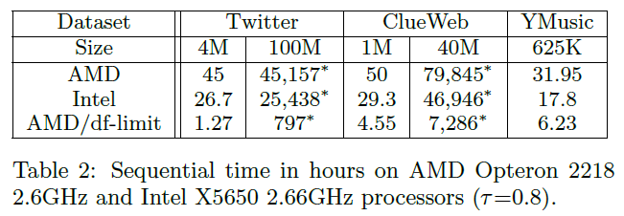
DataSet
Twitter dataset : 100 million tweets (20 million real data and 80 synyhetic data) , feature 18.5 per tweet
ClubWeb : 40 million web pages (ramdomly selected 40M)
feature is 320 per web pages.
Yahoo!Music : 624961 songs ,feature 404.5

Slide 15
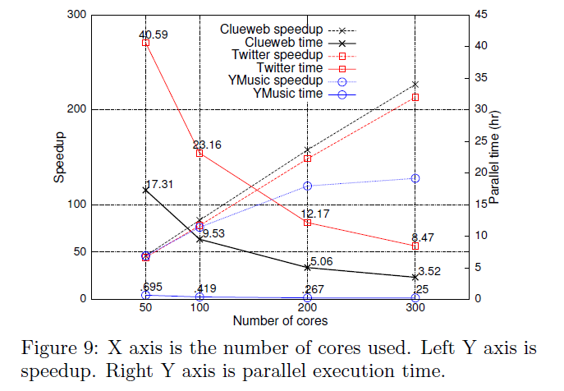
Scalability and Comparisons
Speedup = sequential time / parallel time
Efficiency = speedup / the number of core

Slide 16
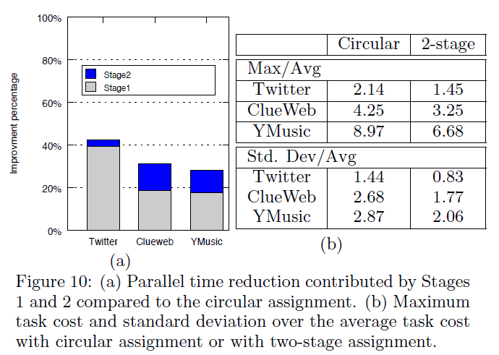
Effectiveness of Two-Stage Load Balance

Slide 17
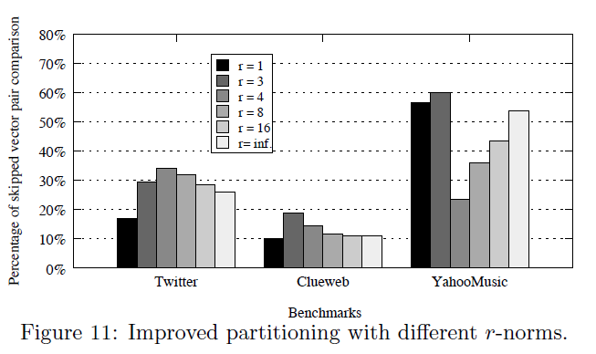
Improved Data Partitioning

Slide 18
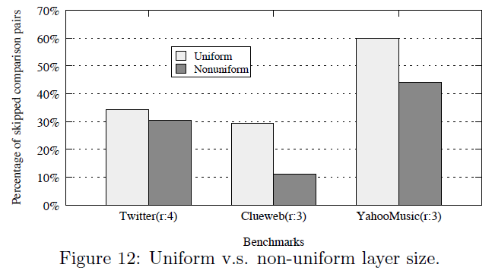

Slide 19
Outline
Introduction
All Pair Similarity Search
Partition-based Similarity Search
Load Assignment Problem
Load Banlancing Optimization
Two-stage algorithm
Data Partition Optimization
Experiments
Conclusion

Slide 20
Conclusion
The main contribution of this paper is a two-stage load balancing algorithm for eciently executing partition-based 200 similarity search in parallel.
Presents an improved and hierarchical static data partitioning method to detect dissimilarity and even out the partitions sizes.

